Slide 1
Food Delivery Crisis Impact & Recovery Dashboard
Presented by : K. Sabari Vasan

Slide 2
Executive Summary / Overview
QuickBite Express, an online food delivery startup, experienced a major drop in customer orders and revenue during the crisis period (June-September2025).
The goal of this analysis was to understand the root causes of the decline, analyze customer and restaurant behavior, and recommend recovery strategies to improve retention, delivery performance, and overall business performance.
Key highlights:
Pre-crisis orders dropped during the crisis.
Customer cancellations including placing orders decreased and delivery delays increased sharply.
Ratings and sentiment scores declined, showing customer dissatisfaction.
Some cities and restaurant partners were more affected than others.

Slide 3
Objective / Problem Statement
To provide actionable insights and data-driven recommendations for recovery and customer retention after the crisis.
PROBLEM STATEMENT:
QuickBite Express observed a sharp decline in orders, revenue, and ratings during the crisis.
Management seeks to identify:
Which customer segments can be reactivated.
Which cities and restaurants were most impacted.
How delivery and service performance changed.
What strategies can restore customer trust and loyalty.

Slide 4
Data Cleaning and Preprocessing Steps
Handled missing values — kept nulls for cancelled or unrated orders to preserve realistic insights.
Merged multiple tables:
fact_orders, fact_order_items, fact_ratings, fact_delivery_performance
dim_customer, dim_restaurant, dim_delivery_partner, dim_menu_item.
Created derived/Calculated columns:
Period (Pre-Crisis, Crisis)
YearMonth and YearMonthNumber for time trend
Customer Status (Loyal, Lost, Recoverable, Dissatisfied)
Converted columns like order_timestamp → Date and formatted values.

Slide 5
Methodology / Tools Used
Descriptive Analysis: To identify patterns and trends in customer behavior, orders, and delivery.
Comparative Analysis: Compared Pre-Crisis vs Crisis across multiple KPIs (orders, revenue, delivery, ratings).
Sentiment Analysis: Used sentiment_score from review texts to understand customer emotions.
Visualization Tools: Created interactive Power BI dashboards for trend tracking and KPI monitoring.

Slide 6
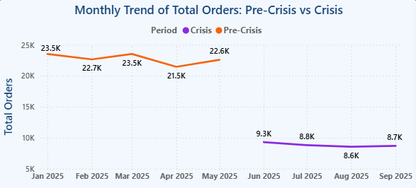
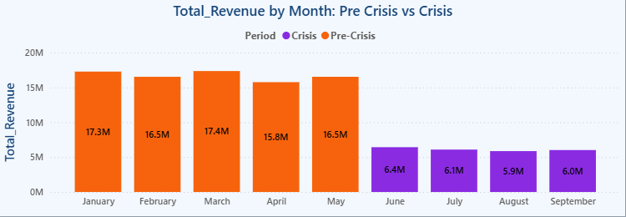
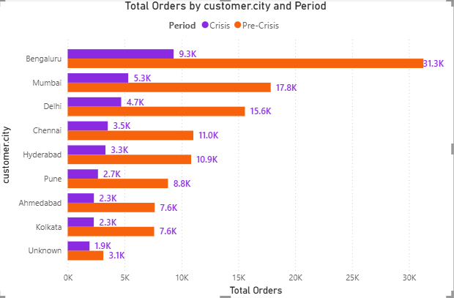
Exploratory Data Analysis (EDA) Findings
Descriptive Analysis → Trends & Patterns
Orders and revenue began dropping sharply from June → start of crisis. Key cities such as Mumbai, Delhi and Bengaluru were heavily impacted.

Slide 7
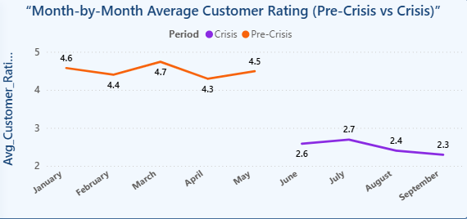
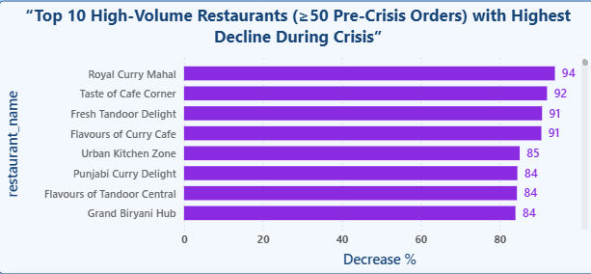
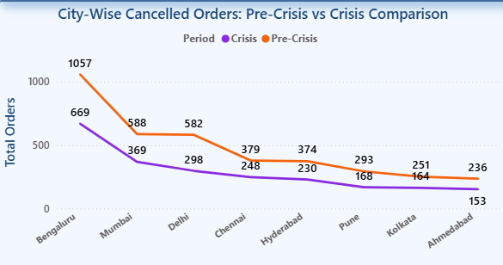
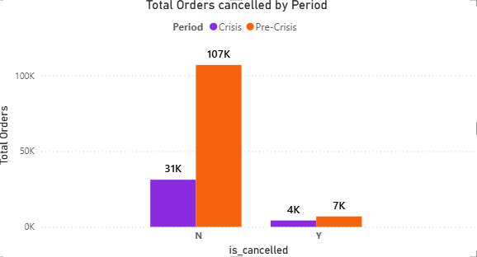
Exploratory data Analysis(EDA)Findings
Comparative Analysis → Pre-Crisis vs. Crisis
Ratings dropped from 4.5 to nearly 2.5 during the crisis. Top restaurants and major cities showed heavy decline, indicating strong business impact.

Slide 8
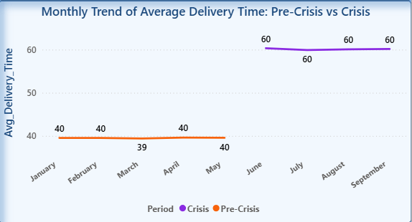
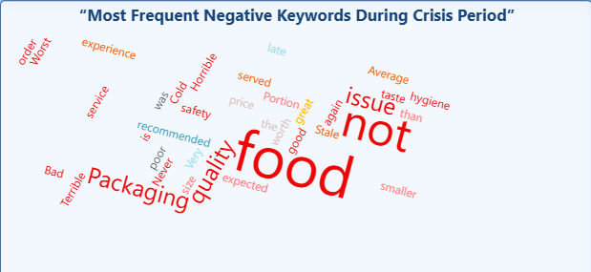
Key Insights and Visualizations
Before the crisis, delivery time was stable and fast, staying around normal levels.
During the crisis, delivery time suddenly increased, and stayed consistently high.
This delay in delivery is the only operational factor visible in the data that explains why orders dropped during the crisis.
Improving delivery time should be a top recovery strategy, as it directly impacts customer behaviour.
Customers frequently complained about “food quality”, “packing”, “late delivery”, “bad experience”.
These issues match with low ratings & high cancellations.
Food quality + speed + packaging must be improved to recover trust.

Slide 9
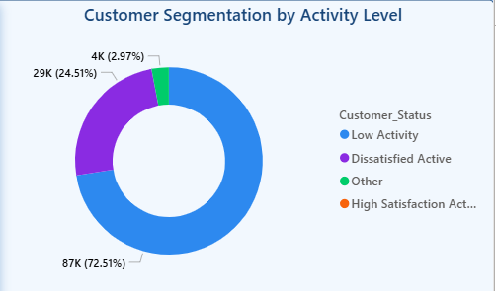
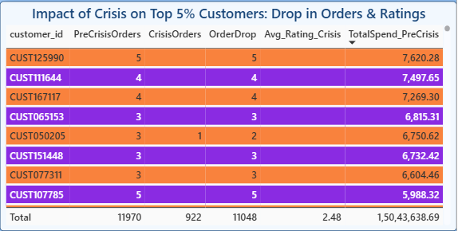
Key Insights and Visualizations
Most customers (72%) - became inactive or very low active(Large opportunity for reactivation campaigns).
Almost 25% are dissatisfied - They continued ordering but likely had bad experiences(Action needed).
Only 3% are highly satisfied These are your strongest loyal segment should be preserved & rewarded.
This visual highlights that even our most valuable customers – the top spenders before the crisis – significantly reduced their orders during the crisis.
Despite being loyal earlier, their order frequency dropped sharply, and their satisfaction levels also decreased

Slide 10

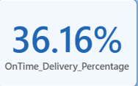

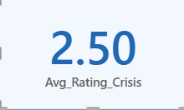
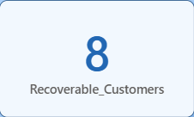
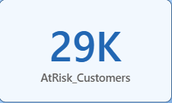
KPIs and Metrics
Order Decrease %
On-Time Delivery %
Total Cancellations
A major drop in total orders during the crisis period — shows how severely customer demand was affected.
Only a small portion of deliveries were completed on time, suggesting operational inefficiency and delivery delays.
Cancellations — indicating customer dissatisfaction or delivery issues.
Avg Rating (Crisis)
Recoverable Customers
At-Risk Customers
Customer satisfaction dropped during the crisis, reflecting frustration with the service (delivery delays, packaging, food quality).
These customers are worth targeting — they ordered earlier but stopped during the crisis. They can be won back with campaigns.
A large group of customers are still active but less engaged. They require retention strategies before they stop ordering.

Slide 11
Interpretation of Results
Decline is multi-factorial: supply chain constraints, delivery delays, and customer trust issues.
Even satisfied customers stopped ordering, meaning operational gaps (delivery & availability) outweighed satisfaction.
Cities with strong pre-crisis order volume saw greater declines — bigger impact on key markets.

Slide 12
Recommendations / Actionable Insights
Customer Recovery
Launch reactivation campaigns (emails, app offers) targeting loyal but inactive users.
Offer personalized discounts for customers with high satisfaction but no recent orders.
Delivery Optimization
Prioritize hiring/training delivery partners in key cities.
Improve SLA monitoring and reduce delays.
Restaurant Partnerships
Strengthen in-house or high-rated restaurant partnerships to ensure service reliability.
Identify and replace non-performing partners.
Sentiment Monitoring
Continuously monitor feedback for early detection of service issues.
Marketing
Run city-based loyalty campaigns where order drops were highest.

Slide 13
Conclusion
The analysis reveals a severe decline during the crisis period.
By focusing on loyal customer recovery, SLA improvement, and active monitoring, QuickBite can rebuild its brand trust and stabilize growth.
Final takeaway:
Recovery depends on operational reliability, not just marketing. Strengthening the delivery network, restaurant partnerships, and customer communication are the keys to a successful comeback.

